Slide 1
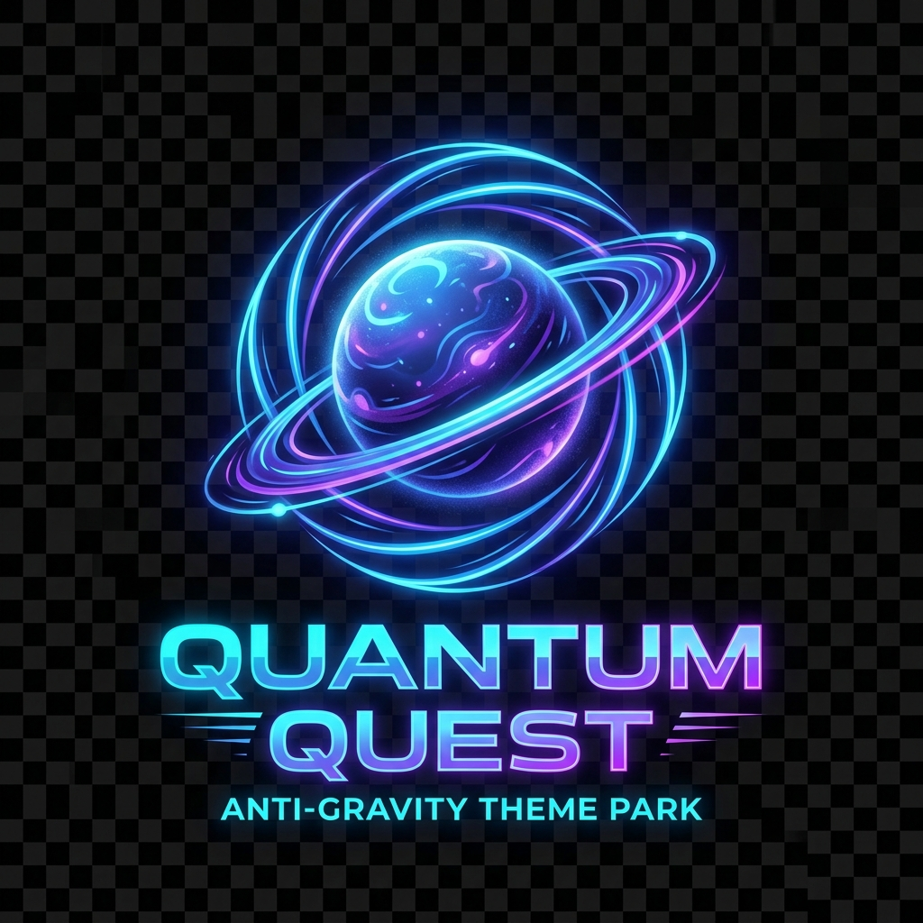
QUANTUM QUEST
Mastering Long Multiplication
Engineering Dept | Mission #506

Slide 2
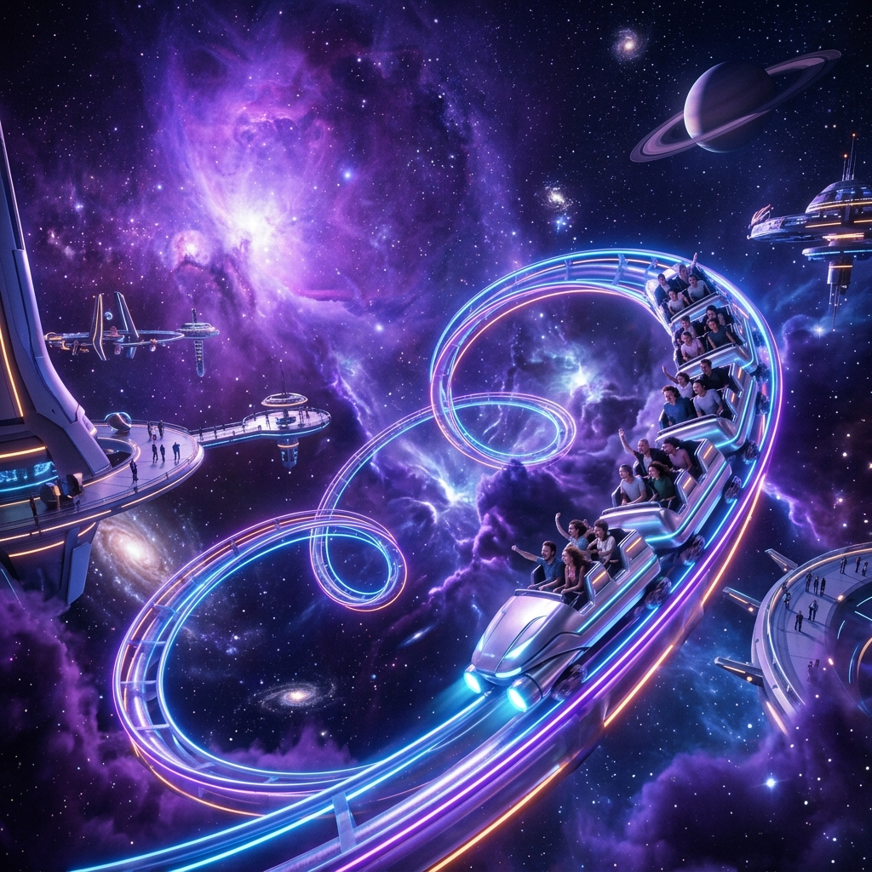
MISSION BRIEFING
Opening Day Logistics
Welcome, Engineers! Quantum Quest is ready to launch, but we need exact numbers.
If we miscalculate, the park's systems will fail!
Today, we use the Long Multiplication Algorithm to ensure success.

Slide 3
THE BLUEPRINT
The 2-Digit Strategy
Example: 36 x 72
Part 1: 36 x 2 = 72
We split the mission into four critical steps:
Part 2: 36 x 70 = 2520
Total: 2592
1. Multiply by the units digit.
2. Drop the Secret Zero.
3. Multiply by the tens digit.
4. Add the results together!

Slide 4
CRITICAL COMPONENT
Don't Forget the Secret. Zero!
We add a zero because we are multiplying by a Multiple of 10.
Multiplying by 7 in 72?
0
Actually, it's 70!
The zero keeps our columns aligned.

Slide 5
ENGINEERING WALKTHROUGH
Scenario: The Zero-G Cafe
24 tables, 53 seats per table. How many total seats?
2
4
1. 24 x 3 = 72
 | 1 | 2
x | 2 | 3
+ |  | 0
2. Drop the 0
x
5
3
3. 24 x 5 = 120
4. Add: 72 + 1200 = 1272
7
2
1
2
0
0
1
2
7
2

Slide 6
ENGINEERING WALKTHROUGH
Scenario: The Zero-G Cafe
Use the grids below to calculate the supplies. The Magic Zero is pre-filled for you!
a) 12 x 23 (Ordering 12 boxes of 23 anti-gravity pins)
 | 1 | 2
x | 2 | 3
+ |  | 0

Slide 7
TEAM CHECK
Mission: Cosmic Coaster
The coaster has 43 carriages. Each carriage holds 31 riders.
Work on your boards: How many riders in a full train?

Slide 8
CHOOSE YOUR MISSION
Select Your Engineering Role
Junior Builder
Senior Engineer
Project Director
Guided grids and smaller numbers.
Standard algorithm for logistics.
Multi-step budget problems.
"Check your blueprint twice, build once!"

Slide 9
QUALITY CONTROL
Spot the Glitch!
12 items at $89 each. Spot the error!
8
9
CRITICAL ERROR!
x
1
2
What did the engineer forget?
How much money was lost?
1
7
8
8
9
2
6
7

Slide 10
MISSION COMPLETE?
Final Security Code
Solve this equation to exit the park:
12 x 89 = ?
Write your answer on your exit ticket!

Slide 11
Quantum Quest is Ready!
Great job, Engineers. The park is safe.
"Precision in practice, excellence in engineering."

